Slide 1
Chapter 2
Image Processing Basics

Slide 2
What will we learn?
How is a digital image represented and stored in memory?
What are the main types of digital image representation?
What are the most popular image file formats?
What are the most common types of image processing operations and how do they affect pixel values?

Slide 3
Digital Image Representation

Slide 4
Raster vs Vector
Raster (or bitmap) image format = one or more 2D arrays of pixels
– Good quality and fast display speed but larger memory storage requirement and size dependency
Vector image format = series of drawing commands
– Resizing without introducing artifact, less size but need to be rasterized for display divices

Slide 5
Example
A binary image and the pixel values in a 6×6 neighborhood
In Matlab it is called logical array of 0's and 1's

Slide 6
A gray-level image and the pixel values in a 6×6 neighborhood
Gray-level, monochrome, grayscale In Matlab most popular are uint8 ( 0=black, 255=white), uint16 (0=black, 65535=white), double (0.0=black, 1.0=white)

Slide 7
Color Images
RGB, a 24-bit number 8bits for each of RED, GREEN and BLUE
Indexed representation. A pixel contains an index to the pallete of colors...

Slide 8
Color Image, R, G and B

Slide 9
Indexed Image...

Slide 10
Some Image File Formats
Lossy vs Lossless Compression
BIN, PPM (PBM,PGM, PNM) – raw pixel data
Need to know all sizes, bytes per pixel etc
BMP – Microsoft Windows
JPEG – most popular for photographic quality images
GIF – uses indexed representation of colors with maximum of 256 colors palette
TIFF – 24bit per pixel (truecolor), 5 different compression schemes
PNG – supports both indexed and truecolor format, patent free replacement for GIF
RAW – adopted by camera manufacturers

Slide 11
Basic Terminology
Image Topology. It involves the investigation of fundamental image properties, such as number of a particular object, number of separate (not connected) regions, and number of holes in an object etc.
Neighborhood. The pixels surrounding a given pixel constitute its neighborhood, which can be interpreted as a smaller matrix containing (and usually centered around) the reference pixel.

Slide 12
(a) 4-neighborhood, (b) diagonal neighborhood, (c) 8-neighborhood

Slide 13
Basic Terminology (cont.)
Adjacency: 2 pixel p and q are 4-adjacent if they are 4-neighbors of each other
8-adjacency – similar.
Paths. A 4-path between two pixels p and q is a sequence of pixels starting with p and ending with q such that each pixel in the sequence is 4-adjacent to its predecessor in the sequence.
8-path – similar.

Slide 14
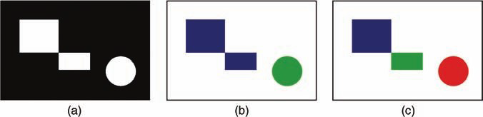
Basic Terminology (cont.)
Connectivity. If there is a 4-path between pixels p and q, they are said to be 4-connected
8-connected
Components. A set of pixels that are connected to each other is called a component. (a) original (binary) image (b) results for 8-connectivity (c) results for 4-connectivity.

Slide 15
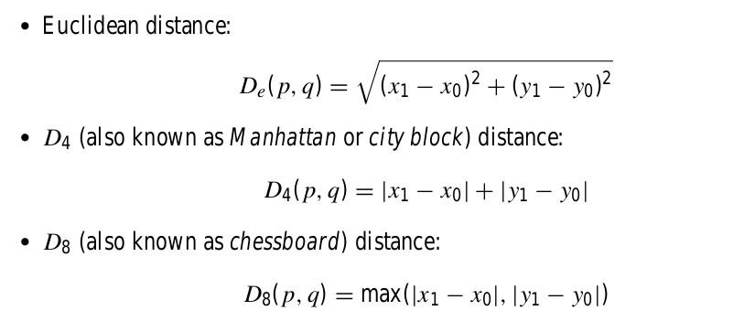
Basic Terminology (cont.)
Distances Between Pixels

Slide 16
Image Processing Operations
Operations in the Spatial Domain
Global (Point) Operations
Neighborhood-Oriented Operations
Operations Combining Multiple Images
Operations in a Transform Domain
Fourier Transform
Discrete Cosine Transform

Slide 17
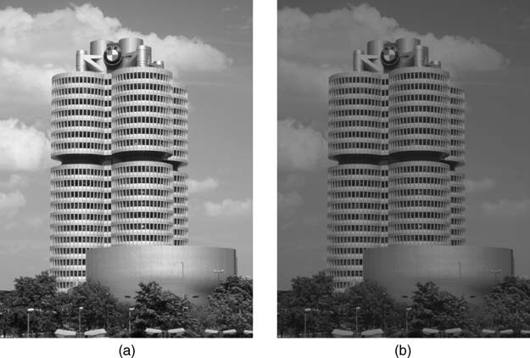
Intensity reduction by 2 (global operation)

Slide 18
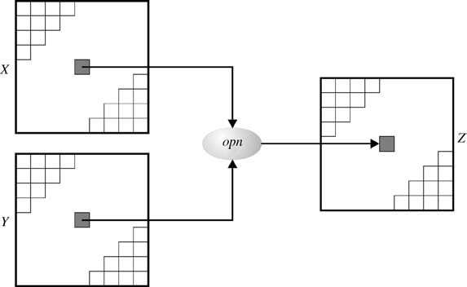
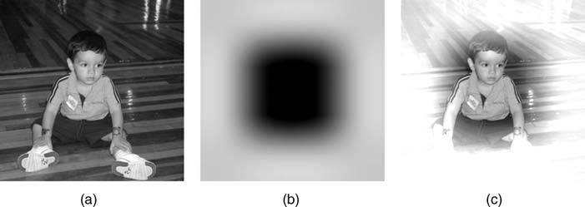
Combining Two Images

Slide 19
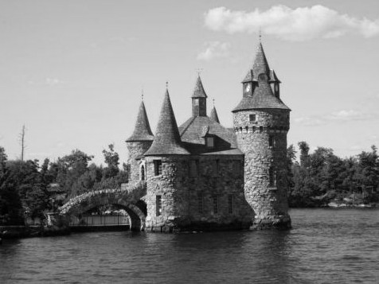
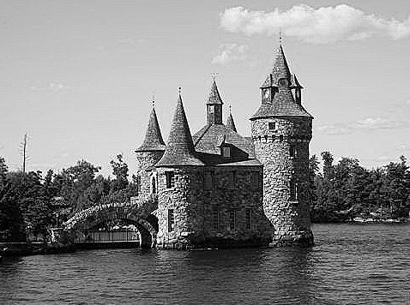
Sharpening an image by neighborhood operation

Slide 20
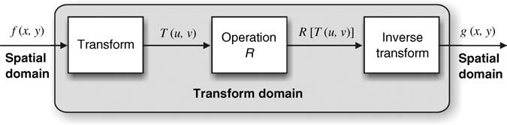
Operations in Transform Domain

Slide 21
References
Practical Image and Video Processing using Matlab, Oge Marques, 2011, Chapter 2

